Slide 1
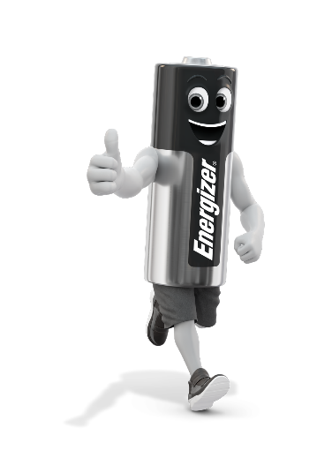

Brand Strength Overview
2019
Portable power everywhere

Slide 2
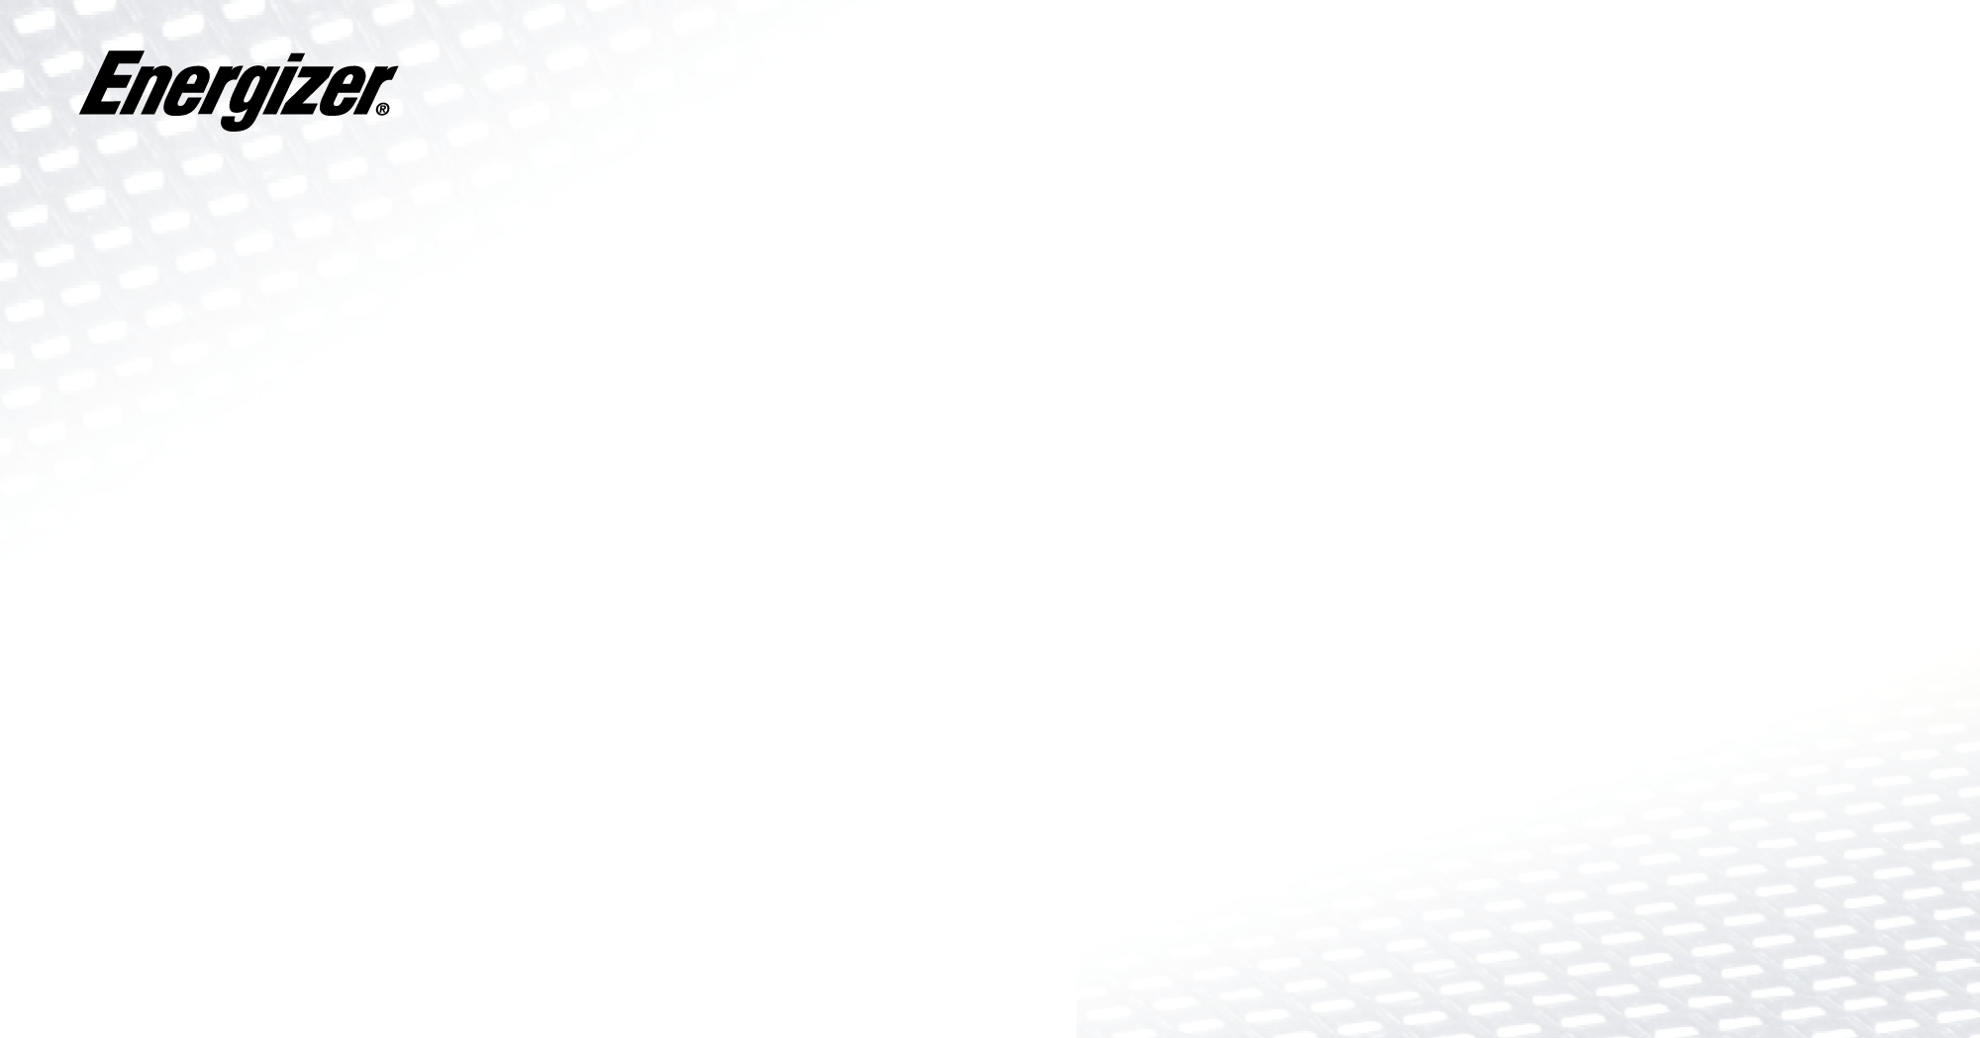

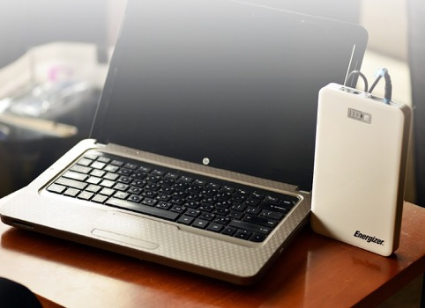
The Energizer® brand is synonymous with world's first innovation and tecgies. We're leading and shaping the power and portable lighting categories with a powerful portfolio of groundbreaking products and consumer-led innovation.​​
About Energizer ®
The Energizer® brand is synonymous with world's first innovation and emerging technologies. We're leading and shaping the power categories with a powerful portfolio of groundbreaking products and consumer-led innovation.​​
Employees: 5,500
Sales 2016: $1.6 Billion
Market Cap: $3.4 Billion
Subsidiaries: Eveready Battery Company, Energizer & More
Type of business: Public company

Slide 3

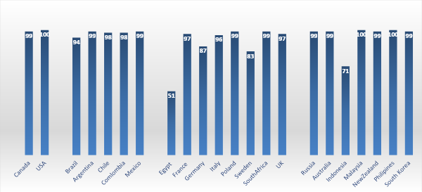
Global Energizer Brand Awareness (%)

Slide 4
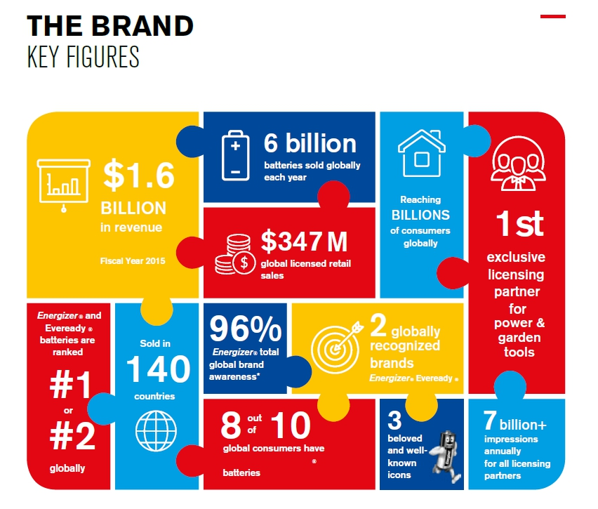

Slide 5










Answer:
Brand recognition: The Energizer Brand has 99%+ positive consumer recognition, resulting in increased sales. Close the sale in the store, don’t lose it to Amazon!
Energizer PowerBank’s will generate terrific sales-though thanks to 99% brand recognition, a great program and enforced MAP pricing.
Great product offering: With the strong HIGHTECH range attractively priced at $19.95-$29.95 MSRP and the ULTIMATE range up to $59.95 sales-through will follow.
Outstanding retail presentation: All products are delivered in high quality and stylish “book style” packaging. POS systems, promotions and much more.
MAP pricing enforced: Energizer has a long history of being a true partner to retailers. Strict enforcement of MAP pricing and NO Groupon, “daily deals” offerings etc.

Slide 6


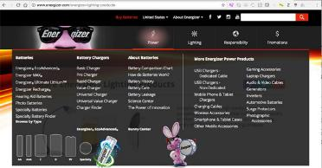
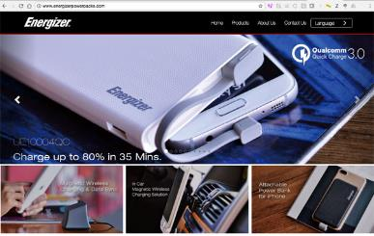


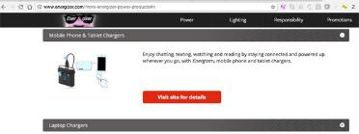
Energizer was founded in 1896,
always headquartered in Missouri. USA
Employees: 5,500
Sales 2016: $1.6 Billion
Market Cap: $3.4 Billion
Subsidiaries: Eveready Battery Company, Energizer & More
Type of business: Public company
Symbol: ENR
Performance & Innovation
The Energizer® brand is synonymous with world’s first innovation and emerging technologies. Beyond power and portable lighting, our real product is bringing positivenergy™ so that you can do, enjoy and accomplish more than you ever expected.​​​​​​​
Energizer website for PowerBank’s
Go to Energizer.com - select “More Energizer Power Products”.
Select “Mobile Phone & Tablet Chargers” or “Laptop Chargers”.
Click on link or go directly to www.energizerpowerpacks.com
www.energizerpowerpacks.com
North America
2017
Product Offering
PowerBank Licensee Partnership since 2009

Slide 7
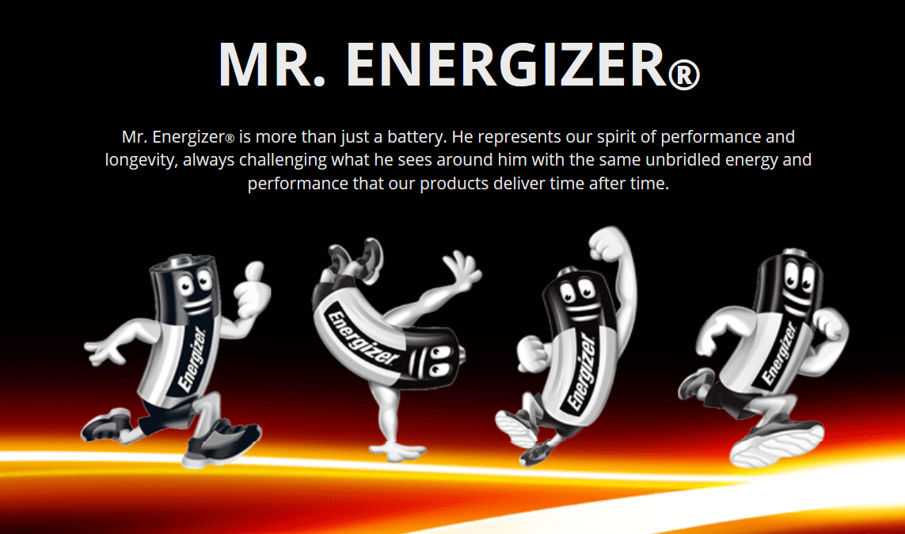

Slide 8
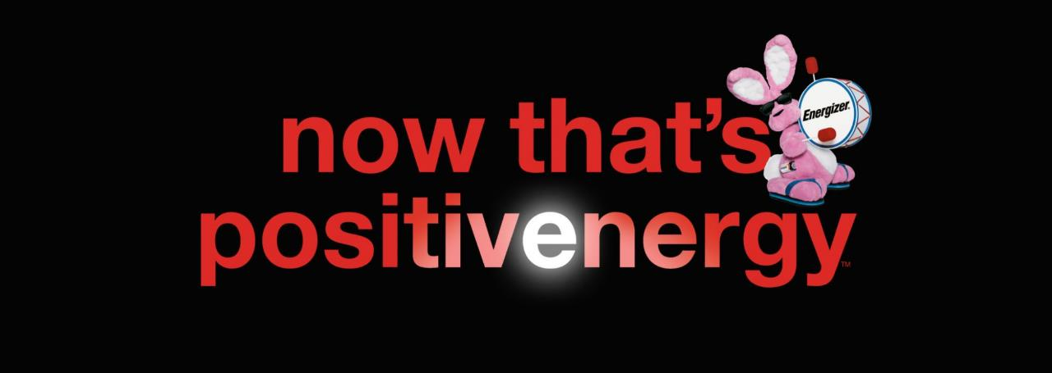
Mr. Energizer®
Mr. Energizer® is more than just a battery. He represents our spirit of performance and longevity, always challenging what he sees around him with the same unbridled energy and performance that our products deliver time after time.
“We believe that everyone has the power to make a positive impact on the world around them,” says Kent Hatton, Brand Group Director, Energizer Canada Inc. “Energizer does it through the products we make and the programs we support, where performance and responsibility are paramount. Today’s consumers are looking for that balance between performance and responsibility that Energizer delivers, and our new brand banner, now that’s positivenergy effectively communicates that.

Slide 9

Energizer Power Bank

Slide 10


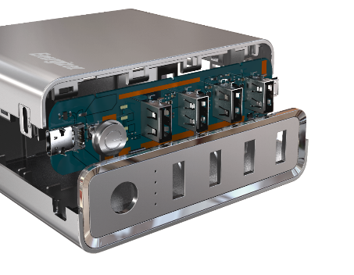




Safety
PowerSafe Management
Complete protection for users and their devices
Short Circuit Protection
Overdischarge Protection
Overcurrent Protection
Overcharge Protection

Slide 11



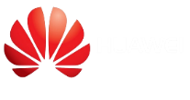
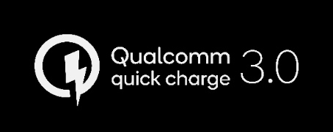


Latest Charging Technology
Power Delivery 3.0
FCP
Wireless Charging
For iPhone and Google pixel
Fast Charge Protocol
Low Current Mode
For blue tooth earbuds
Apple Watch
For Samsung

Slide 12

22 steps of production and quality control

Slide 13
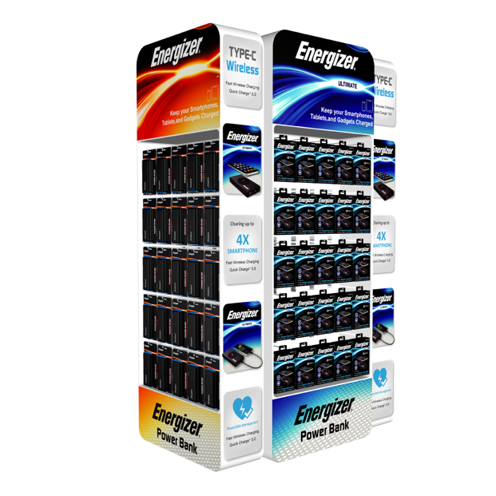
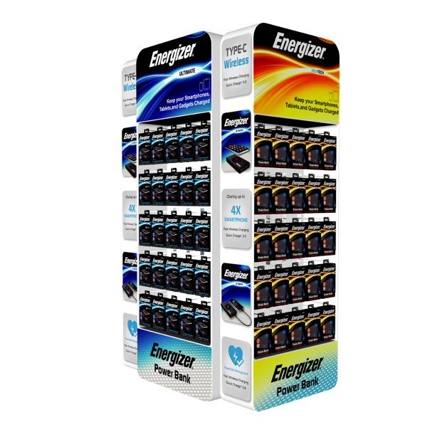
Planogram

Slide 14



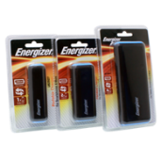
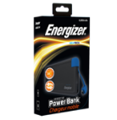
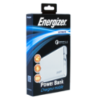

MAX
HIGHTECH
ULTIMATE
MAX - Entry Level | HIGHTECH - Main Retail | ULTIMATE – Telecom
The MAX product offering is the ideal choice for the entry level offering. Great for Grocery Stores, Pharmacies or Online Retailers. | The HIGH-TECH product offering is positioned as a great high value offer suitable for mainstream Retailers such as Best Buy, Target, Home Depot etc. | The ULTIMATE products includes advanced features type MFI approval, Qualcomm QC 3.0 or Type C charging. Ideal for Telecom Operators and high end or specialty Retail.
Blister-pack Retail Packaging Basic Power Bank Product Limited Product Selection (1 Series) Less then traditional channel markup Pricing $9.95 to $29.95 MSRP | Orange “Hi-Tech” book-style packaging High Quality high value Products 4 Product Series - over 8.000 m Typical 50% channel margin Pricing $19.95 to $29.95 MSRP | Blue “Ultimate” book-style packaging Advanced Products with unique features 5 Product Series Typical Telecom channel margin Pricing from $34.95 to $59.95

Slide 15
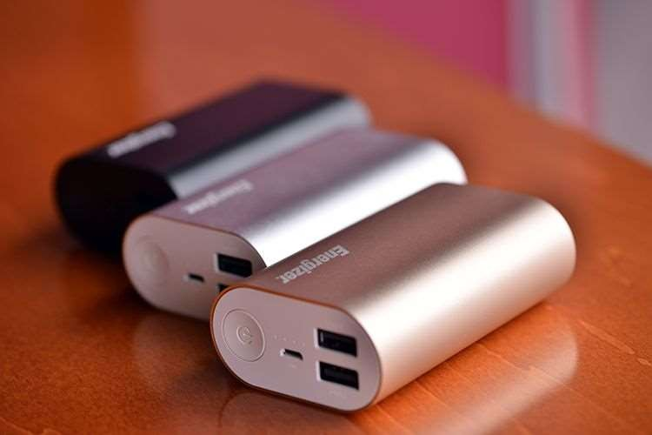
Max Series
Design Performance Specification Price orientated

Slide 16
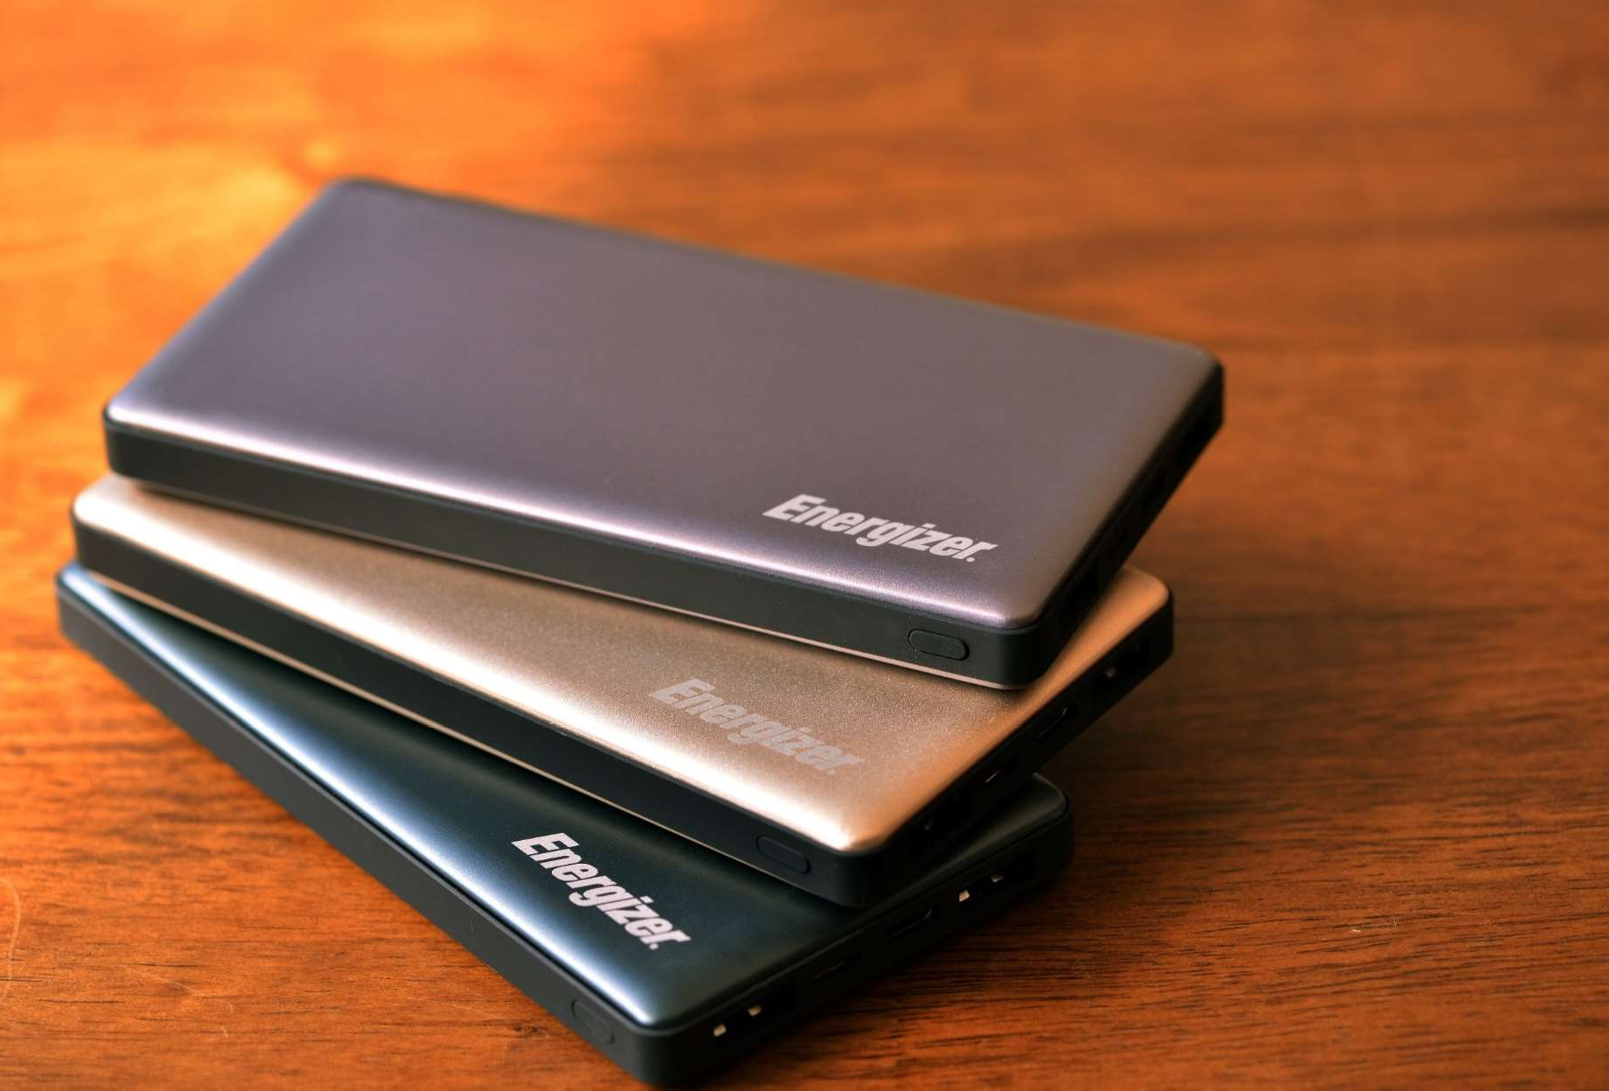
Hightech Series
Design Market Technology Convenience

Slide 17
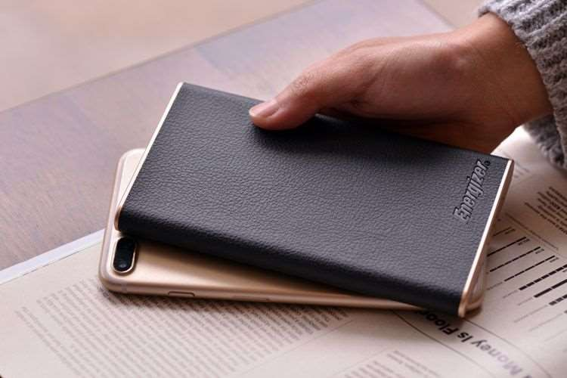
Design Powerful
Ultimate Series
Advanced Technology
Convenient cable management system

Slide 18
Portable Power Everywhere

Slide 19

Asia Pacific :
Countries been covered:
Korea , Vietnam , Japan , Taiwan , Maylasia , Indonesia ,
Srilanka , New zealand , Austrilia , Tailand, Singarpore, Turkey , Philippines, HongKong , Israel ,Cambodia
Middle East:
Dubai ,Qatar , Syria, Moroco , Egypt, Saudi Aribia ,
Fiji ,GuamSolomon Islands, Papua ,New Guinea ,Samoa, American Samoa,
Tahiti New Caledonia.
30 countries established

Slide 20

Countries been covered:
Europe :
UK ,France , Germany , Italy , Finland, Nodic (Denmark, Finland , Sweden , Norway) Russia , Czech Republic, Canary Islands, Baltic (Lithunia , Lativia , Estonia ) ,Ireland , Switzerland
16 countries established

Slide 21

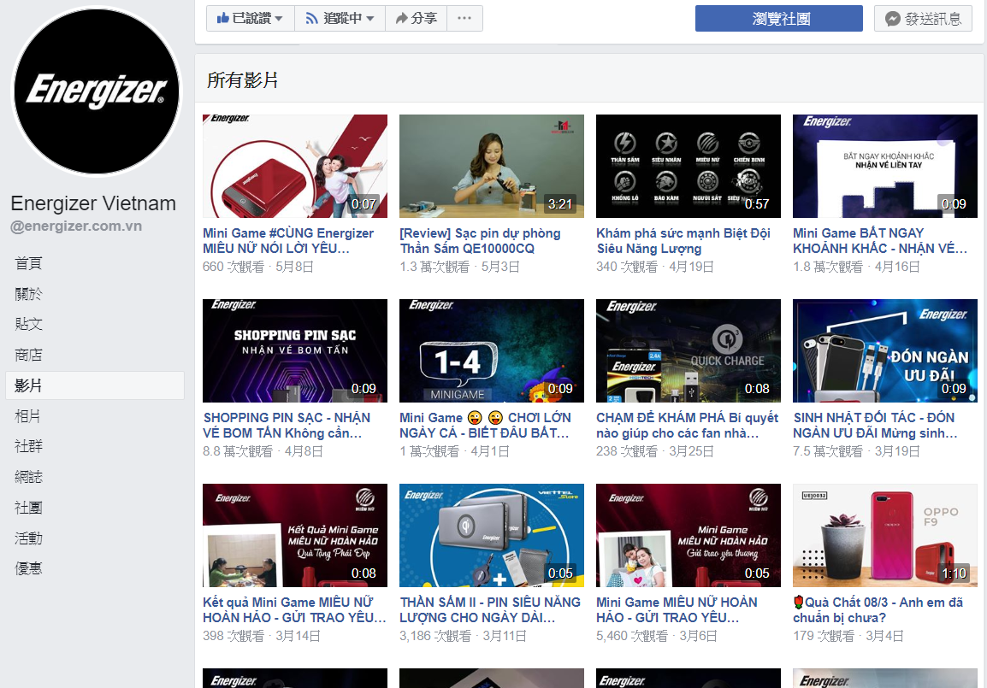
Social Media

Slide 22

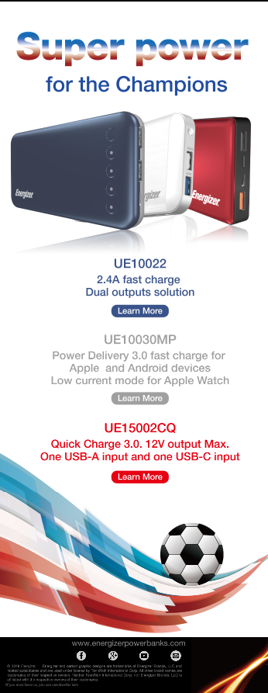
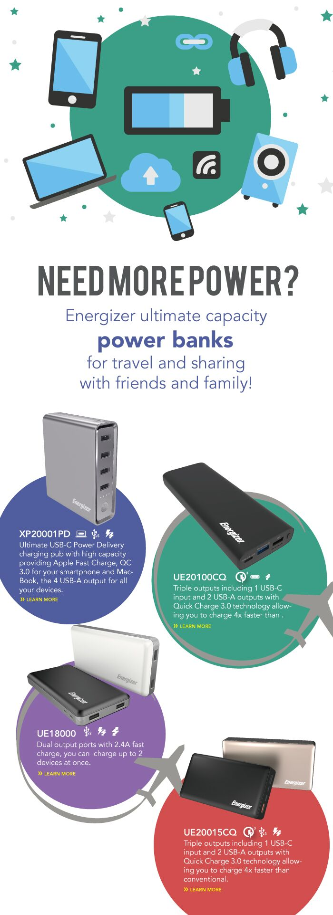
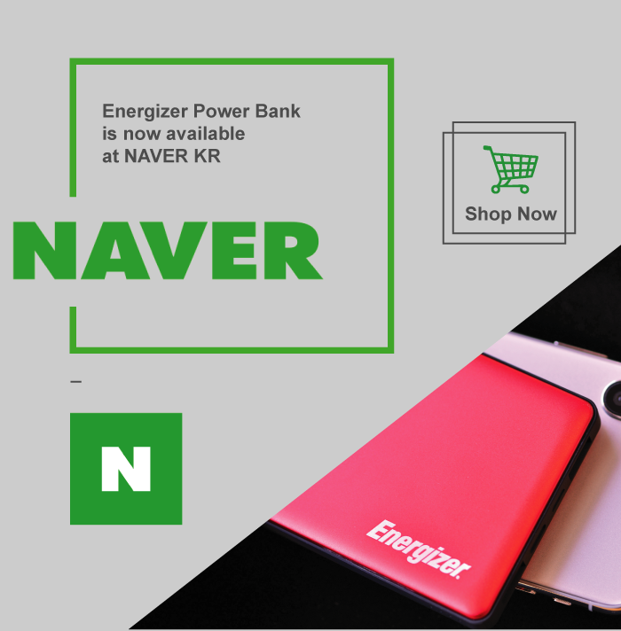
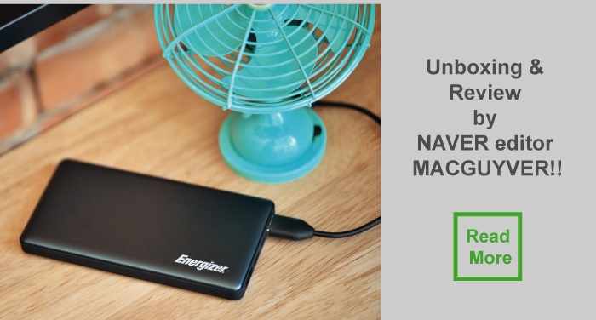
News
Letter

Slide 23


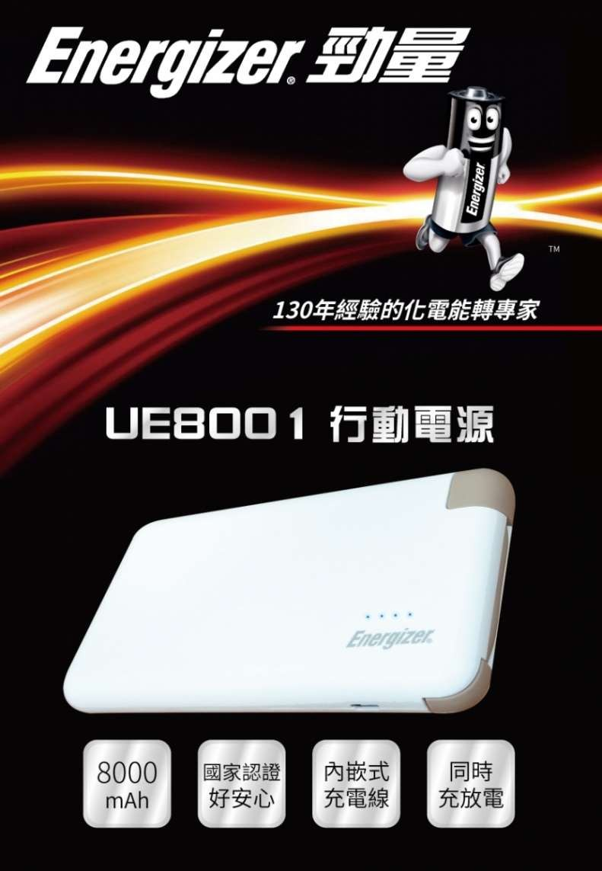

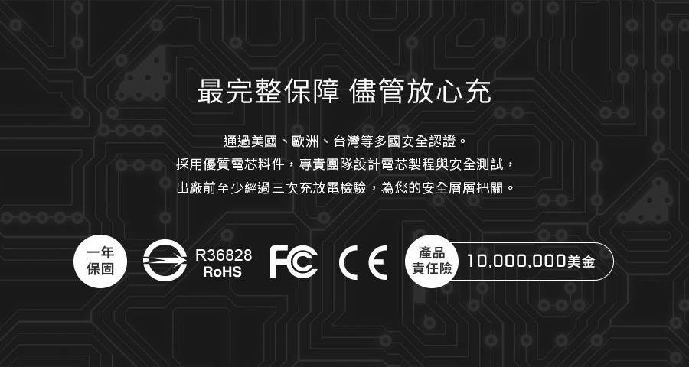
Global Market Activity – Taiwan

Slide 24

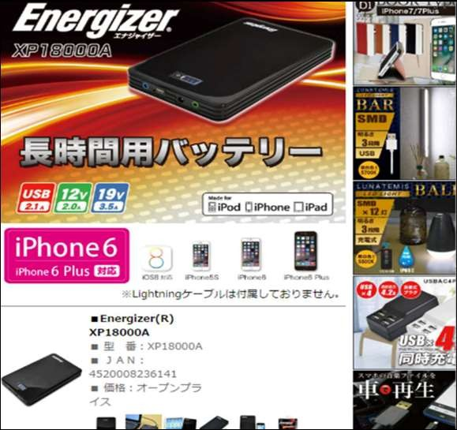
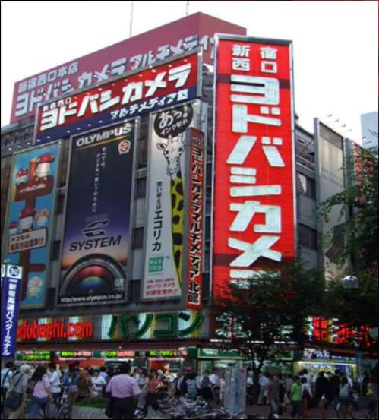
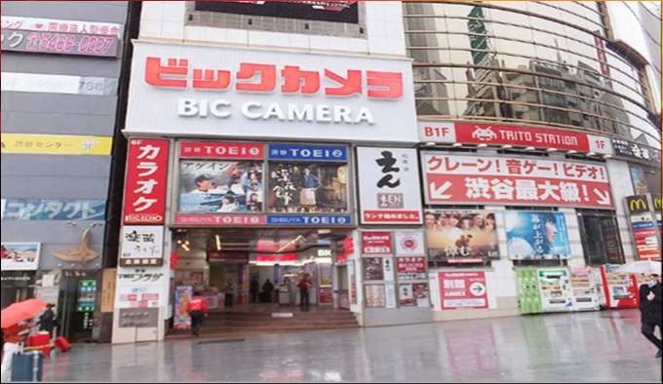
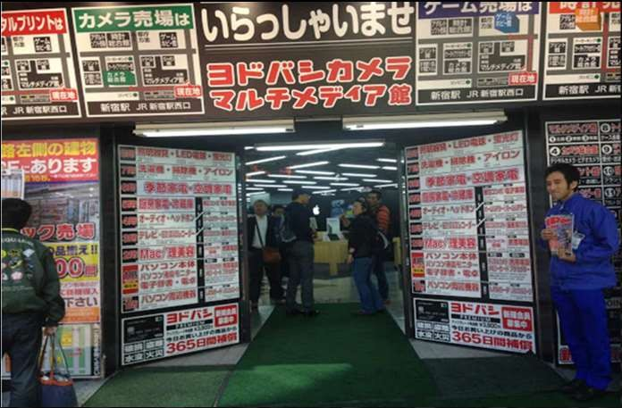
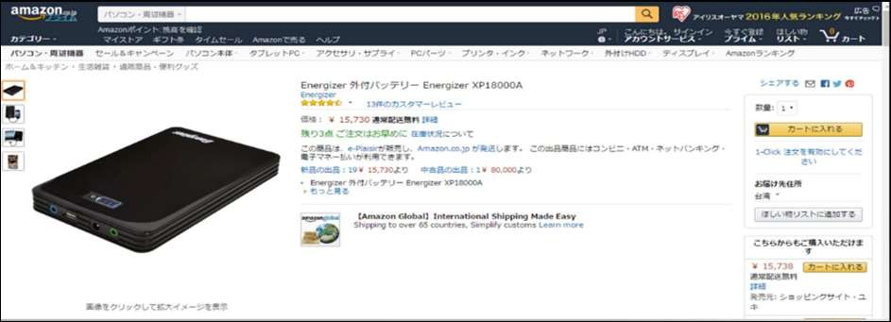
Global Market Activity – Japan

Slide 25

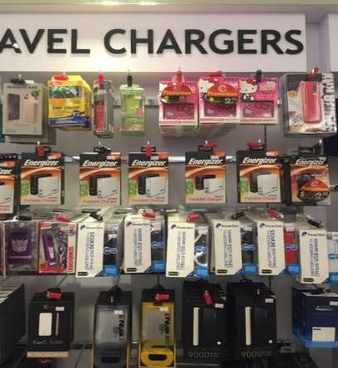
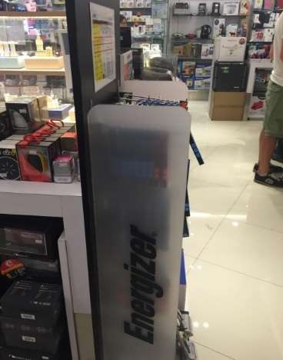
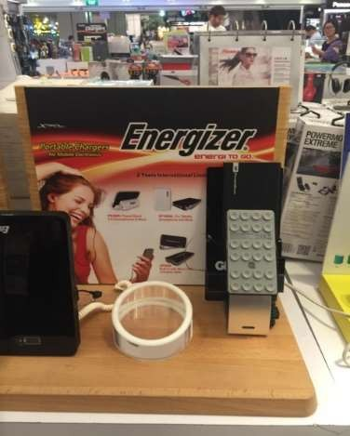
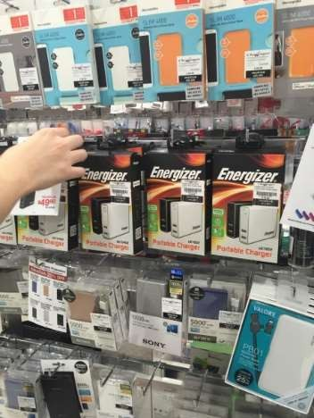
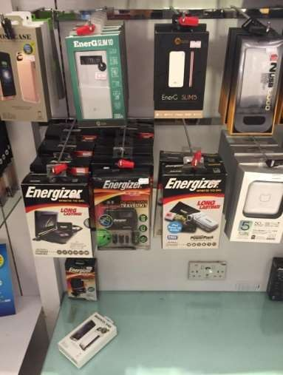
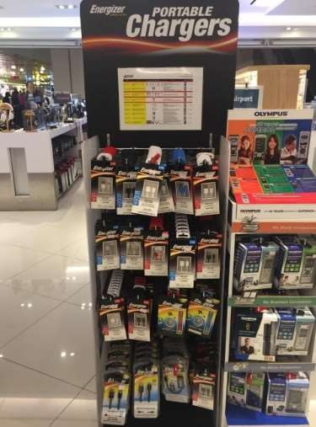
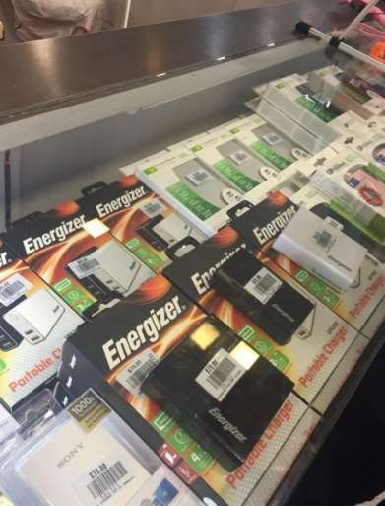
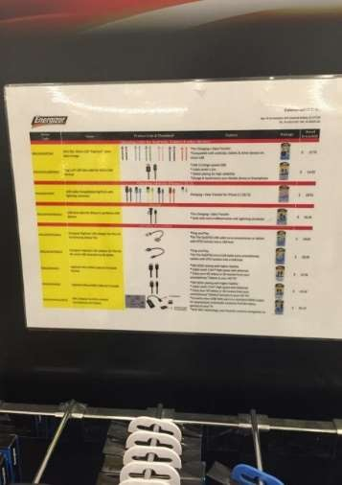
Global Market Activity - Singapore

Slide 26

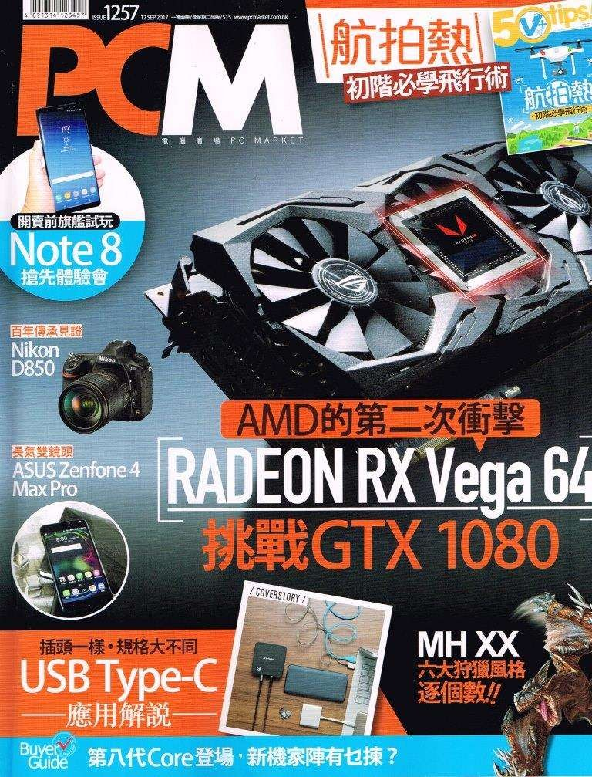
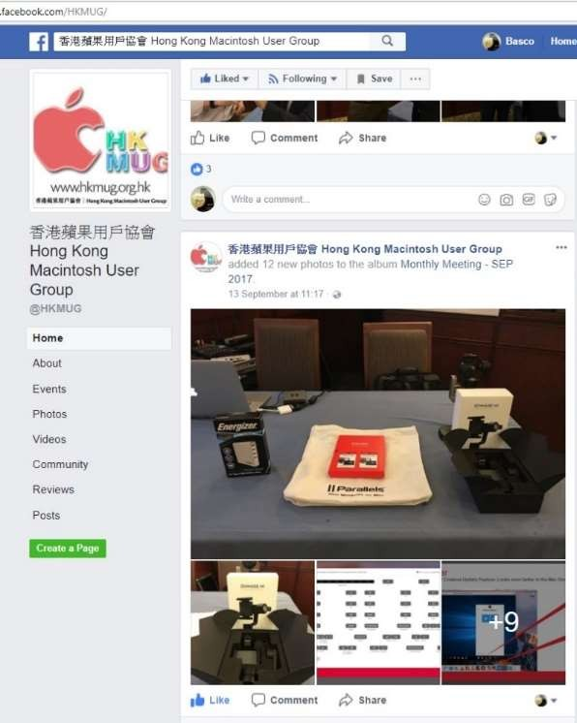
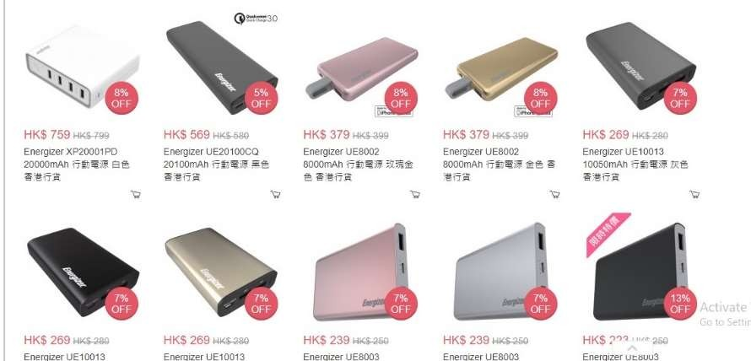
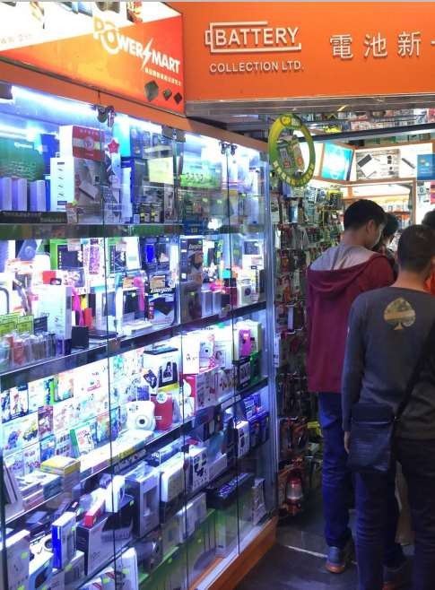
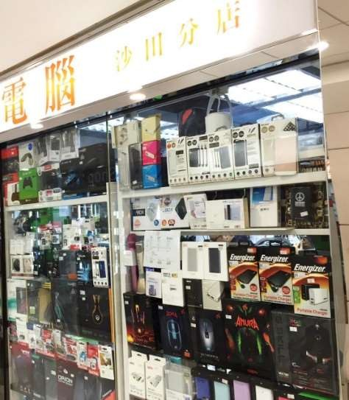
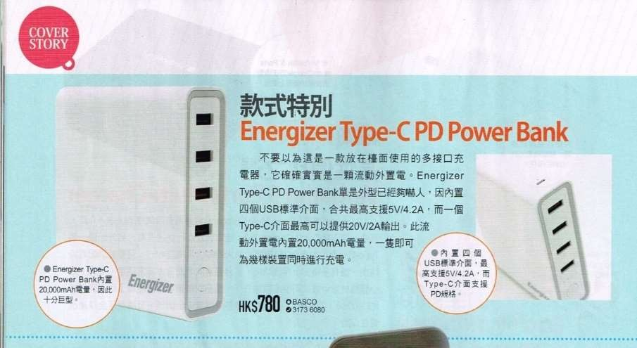
Global Market Activity – Hong Kong

Slide 27

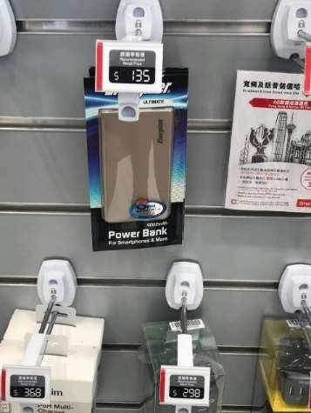
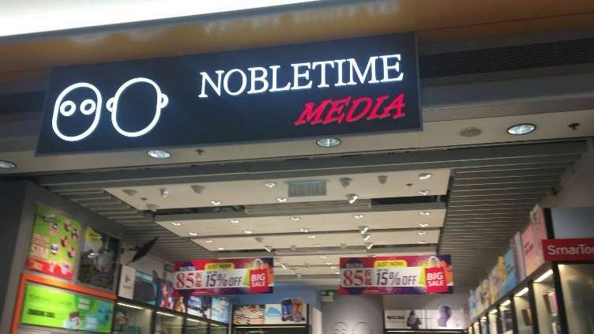
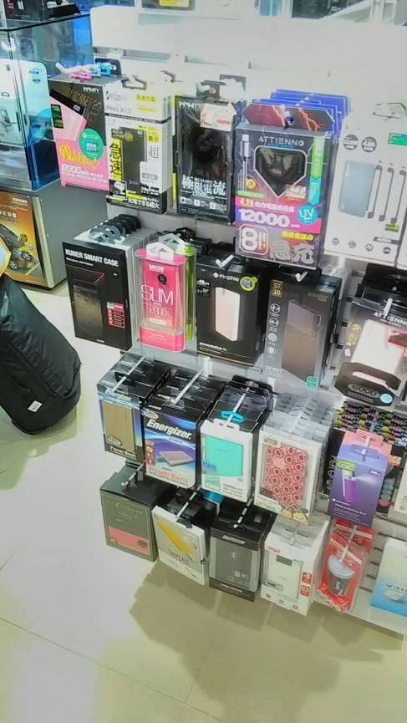



Global Market Activity – Hong Kong-duty free

Slide 28







Global Market Activity - Cambodia

Slide 29







Global Market Activity - Indonesia

Slide 30




Global Market Activity - Malaysia

Slide 31




Global Market Activity - Malaysia

Slide 32




Global Market Activity - Malaysia

Slide 33



Global Market Activity - Korea

Slide 34

Global Market Activity - Korea

Slide 35







Global Market Activity - Korea

Slide 36




Global Market Activity - Vietnam

Slide 37




Slide 38









Global Market Activity - Vietnam

Slide 39




Global Market Activity - Vietnam

Slide 40




Global Market Activity - Thailand

Slide 41



Global Market Activity – Qatar

Slide 42





Global Market Activity – Saudi Arabia

Slide 43


Global Market Activity – Middle East

Slide 44


Slide 45







Global Market Activity – USA online

Slide 46





Global Market Activity – UK

Slide 47





Global Market Activity – UK

Slide 48




Global Market Activity – New Zealand

Slide 49



Global Market Activity – Ghana

Slide 50

THANK YOU
PT JOYFULL TECHNOLOGY INDONESIA

